Slide 1
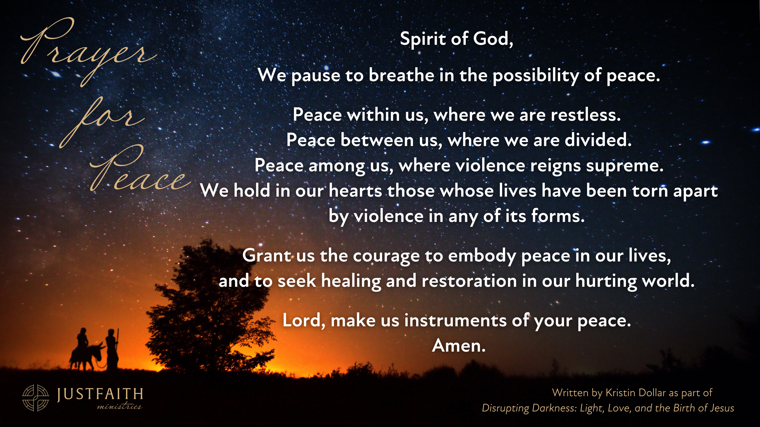

Slide 2
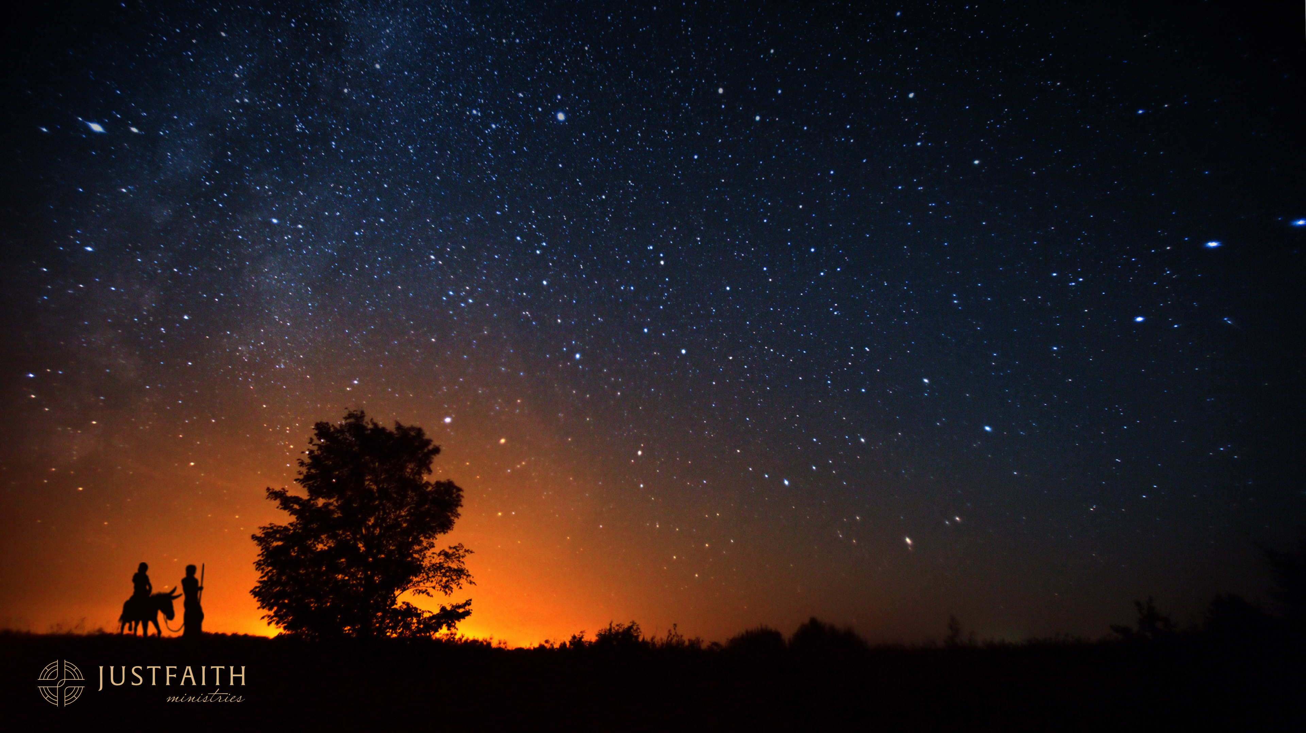
Prayer
for
Peace
Spirit of God,
We pause to breathe in the possibility of peace.
Peace within us, where we are restless.
Peace between us, where we are divided.
Peace among us, where violence reigns supreme.
We hold in our hearts those whose lives have been torn apart
by violence in any of its forms.
Grant us the courage to embody peace in our lives,
and to seek healing and restoration in our hurting world.
Lord, make us instruments of your peace.
Amen.
Written by Kristin Dollar as part of
Disrupting Darkness: Light, Love, and the Birth of Jesus

